Slide 1
Mapping the creative industries in Mexico Meetup data
Juan Mateos-Garcia
Taller de arranque: Mapa Creativo Transmedia México
8 – 9 Febrero
Ciudad de México

Slide 2
Structure
What is meetup and how it fits in the project?
Working with the Meetup data
Data collection and processing
Some initial results
Conclusions and next steps

Slide 3
1. What is Meetup and how does it fit in the project?
A platform to organise events. 35 million members, 300,000 groups, and an open API!

Slide 4
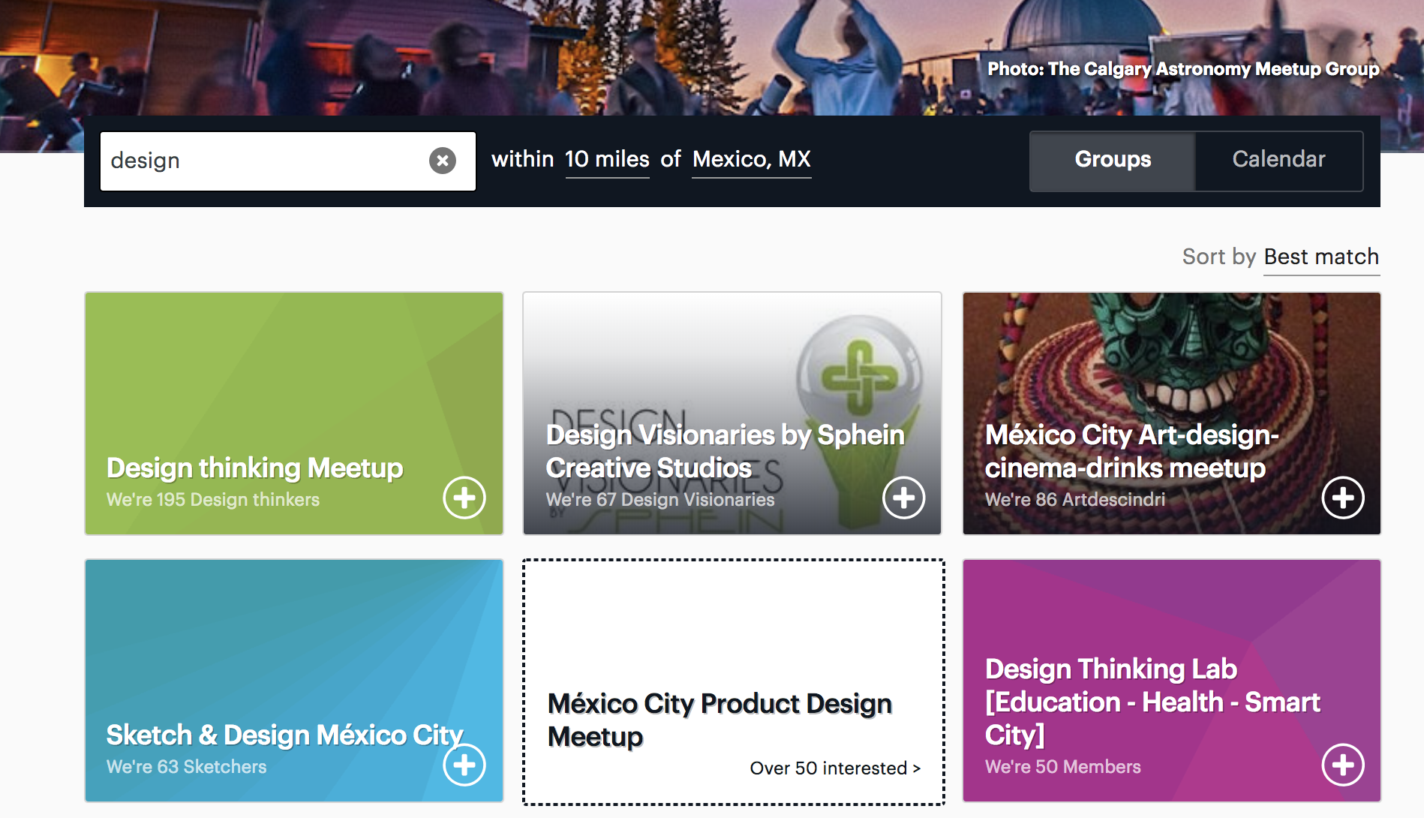
1. What is Meetup and how does it fit in the project?
Significant participation by creative and tech communities

Slide 5
1. What is Meetup and how does it fit in the project?
Creative industries/clusters are...
DENUE limited because...
How could Meetup data help?
Highly networked locally/regionally/ Internationally
It doesn’t include any data about company links
It doesn’t include any data about company links
Involve crossover between domains and new industries
Classifies companies into a single sector based on retrospective categories
Classifies companies into a single sector based on retrospective categories
Rely on freelancers and community groups
Uses businesses as the unit of analysis
Uses businesses as the unit of analysis

Slide 6
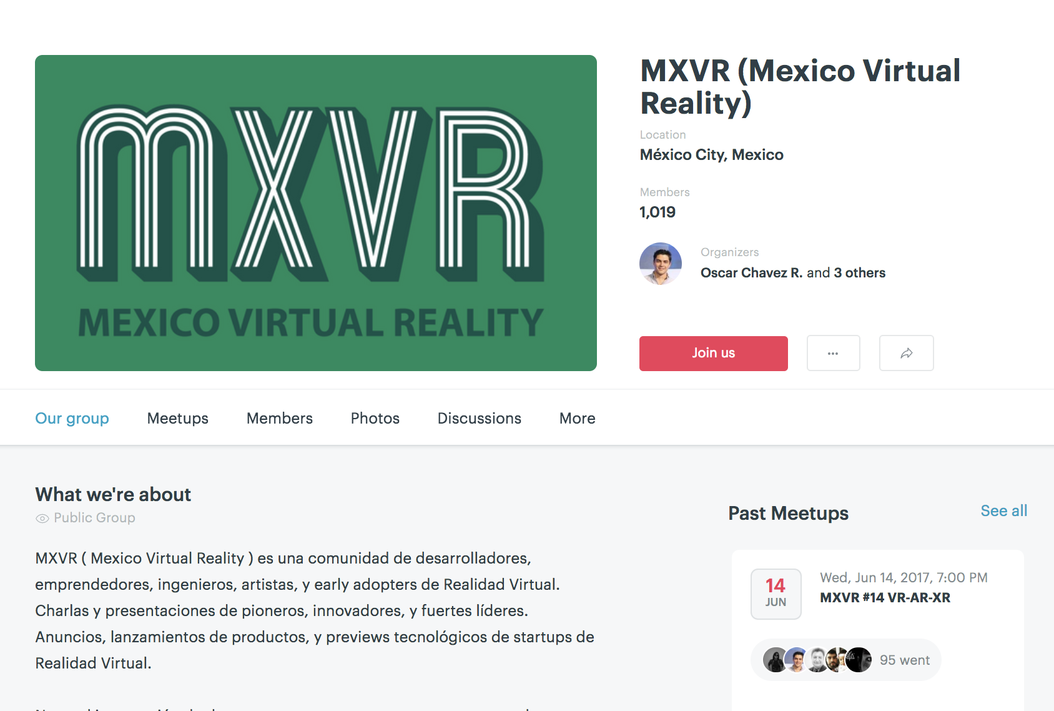
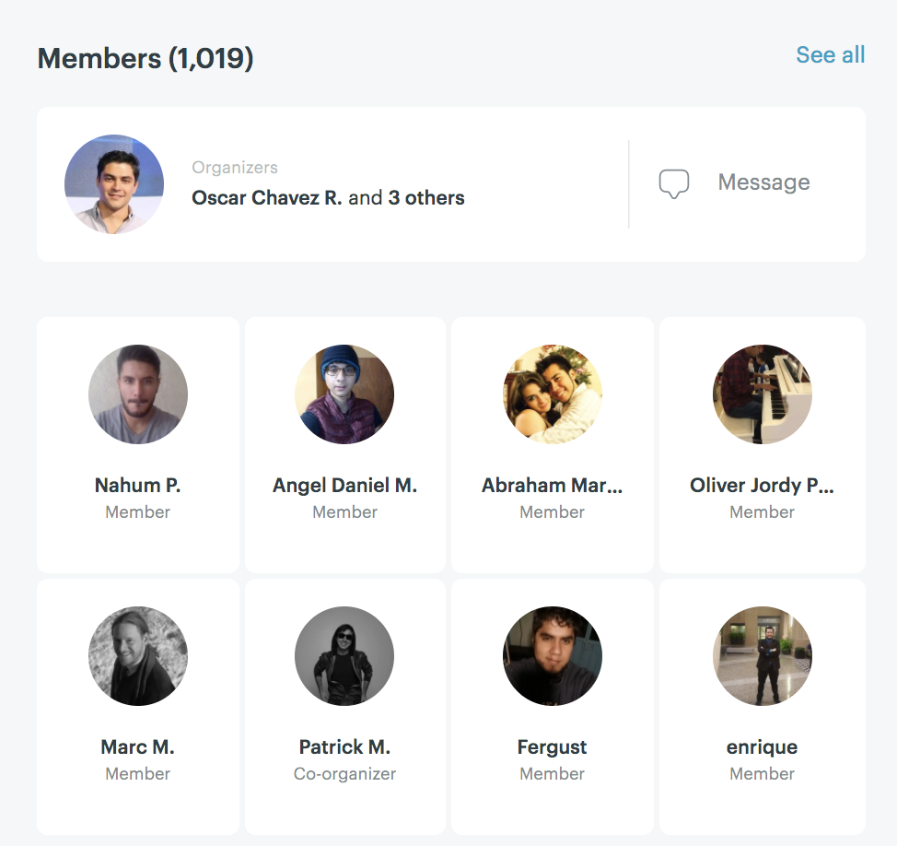
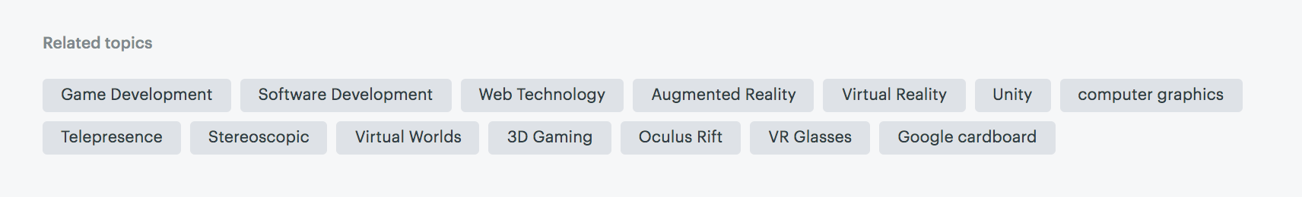
2. Working with the Meetup data
Groups have a presence in the platform, including its location
Members subscribe to groups
Group organisers tag their groups with keywords

Slide 7
2. Working with the Meetup data
A lot of processing before analysis
We go from 2053 unique tags to 46 categories and 6 creative sectors

Slide 8
2. Working with the Meetup data
We have identified 1163 groups with ~278000 members (61K unique users)

Slide 9
2. Working with the Meetup data
There has been fast growth in activity in many topics...not just creative. We can benchmark w/ other countries

Slide 10
2. Working with the Meetup data
42% of the groups in Mexico DF (similar concentration to what we get in industries). But also significant activity in Jalisco & Nuevo León (15% of total each)
We should analyse trends by state and compare results with the creative specialisation data

Slide 11
2. Working with the Meetup data
55% of users are members of more than one group, and 10% are members of meetup groups in more than one state.
We can use this information to start to measure local and regional connectivity. We could also use these data to look at crossover between sectors and fields.
A preliminary analysis detects interesting connections between Mexico DF, Jalisco & Nueva León.

Slide 12
Conclusions and next steps
Analysis so far is very preliminary but it looks like Meetup will be an interesting addition to the project!
We need to further develop the NLP and network analysis, also using event attendance data too.
We also have EventBrite data but it’s not as rich.
Triangulate results vs. industrial activity data from DENUE

Slide 13
Juan.mateos-garcia@nesta.org.uk
@jmateosgarcia

